Slide 1

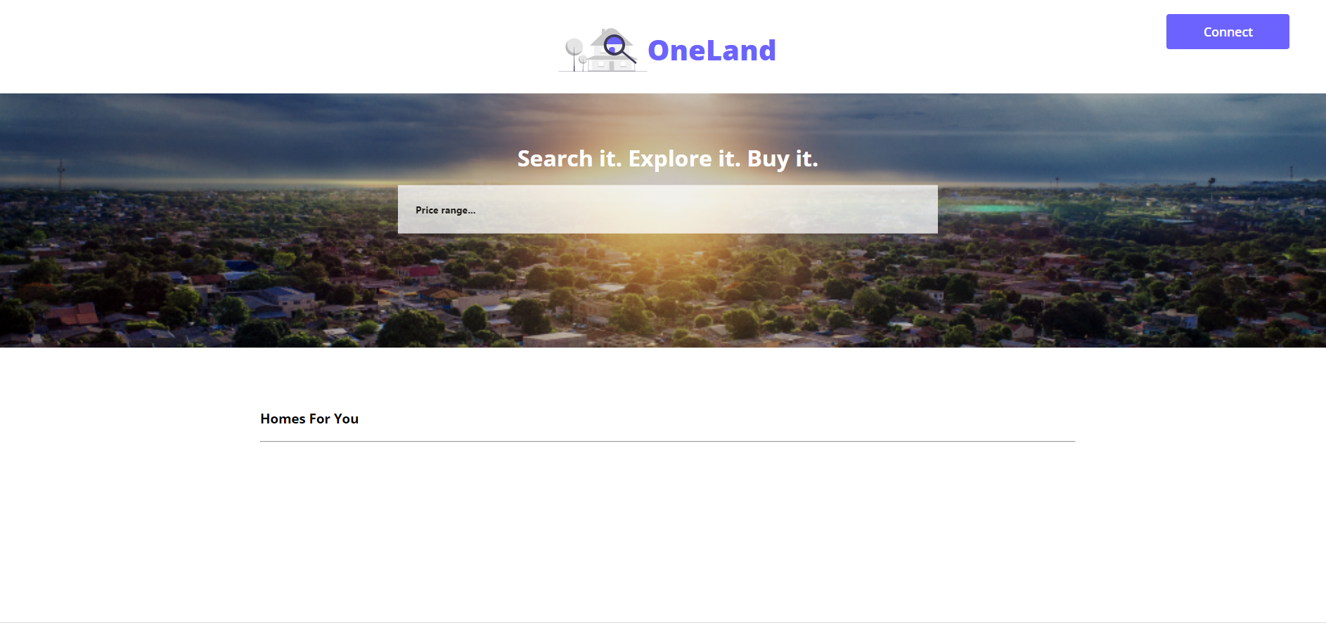
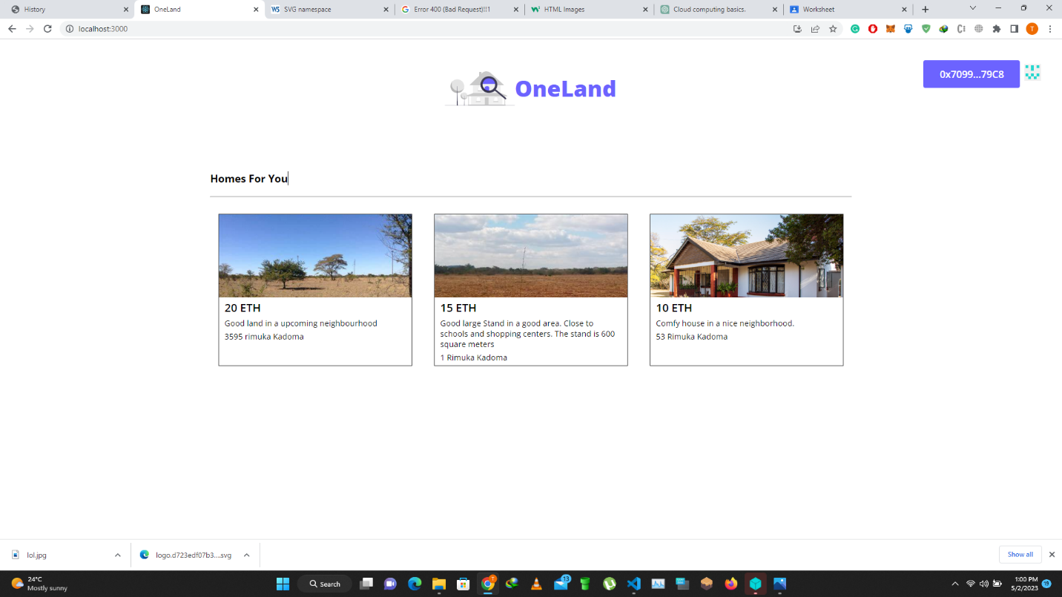
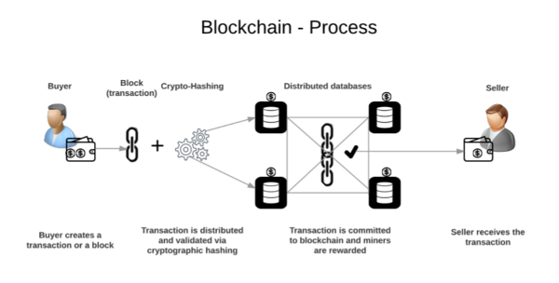
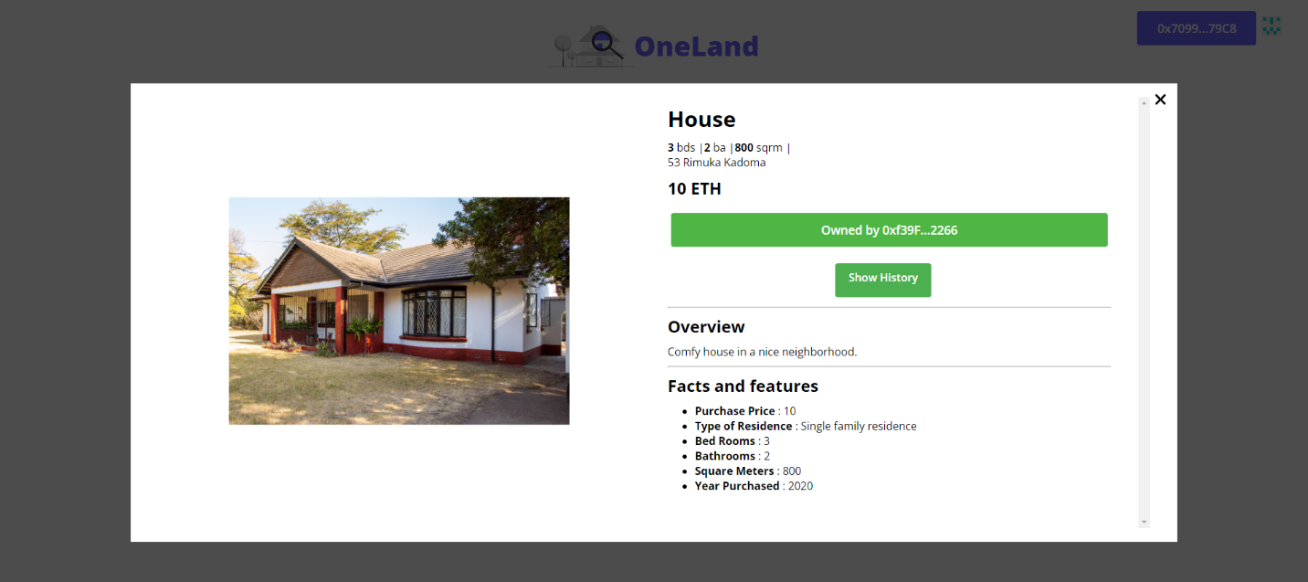
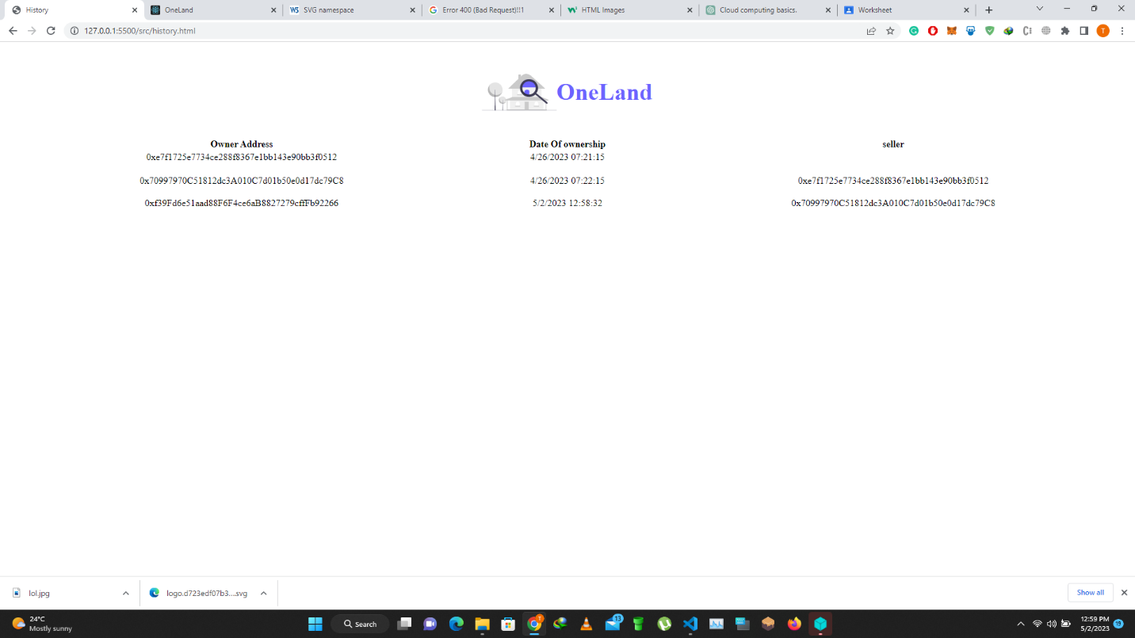
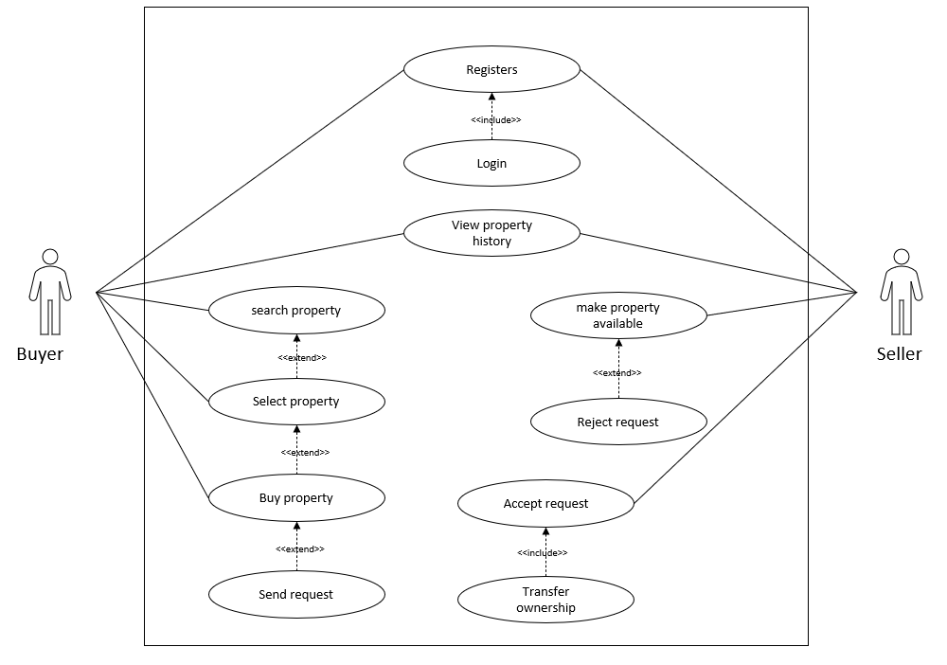
OneLand: A BLOCKCHAIN-BASED REAL ESTATE MANAGEMENT SYSTEM
Takudzwa Matiki- Software Engineering Department
1.0 Abstract
Moreover, blockchain enables the implementation of smart contracts, self-executing agreements that automate various aspects of real estate transactions, including property transfers and payment processing. Smart contracts enhance efficiency, eliminate errors, and foster trust among parties.
One significant benefit of blockchain in real estate management is the establishment of a single, immutable source of truth for property records. This eliminates discrepancies and disputes arising from fragmented or inconsistent data sources. Additionally, blockchain enables the tokenization of real estate assets, representing ownership rights through digital tokens. This opens up new opportunities for fractional ownership, liquidity, and investment in the real estate market.
Furthermore, blockchain enables the adoption of smart contracts, optimizing contract formulation and negotiation. Through a consensus service, transaction ordering and immutability mechanisms are ensured, while a membership service enhances auditability and accountability in trustless environments. Automating contract execution becomes possible, creating a more efficient and secure real estate ecosystem. This potential adoption of blockchain-based solutions can empower smart city developers, allowing for a decentralized asset ownership, trading, and exchange without reliance on a central server system.
Smart contracts: Smart contracts are used to automate property transactions, ownership transfers, and property management tasks.
User interface: The system includes a user friendly web interface for users to interact with the blockchain network.
Database: The system utilizes a centralized database for storing property data, such as property records and ownership details
8.0. Screenshots
The real estate industry has long been plagued by problems such as fraud, double sales, and lack of trust, leading to significant challenges for buyers and sellers. This abstract presents a proposal for a blockchain-based real estate management system that aims to address these issues and provide a secure, transparent, and efficient solution.
The proposed tools for developing the system include Solidity for writing smart contracts, Ganache for launching the Ethereum network, Truffle for testing and developing the blockchain network, JavaScript for the frontend, and MetaMask to create a blockchain browser. The resulting decentralized application (dApp) will run smart contracts, enable tokenization of land properties as NFTs, support decentralized data storage, and maintain immutability.
The decentralized nature of the system ensured the security and integrity of the stored data. The immutability of the blockchain prevented data tampering, reducing the occurrence of fraudulent activities. This robust security feature offered by the blockchain technology attracted developers and stakeholders, as it guaranteed the protection of records and prevented fictitious sellers from exploiting the system. By implementing this blockchain-based system, buyers and sellers can have increased confidence in the authenticity and accuracy of property ownership records, fostering a more transparent and trustworthy industry.
5.0. Objectives
To facilitate the buying and selling of land assets
To create a distributed ledger that enhances the security and transparency of real estate transactions
To streamline real estate transactions and reduce the need for intermediaries such as housing cooperatives and agents
To create an unmodifiable history of all the transactions that have been performed on a land asset.
To enable the minting of currently owned land assets
To reduce costs associated with manual tasks and human involvement, automating processes using smart contracts and blockchain
6.0. System Overview
2.0. Introduction
3.0. Problem definition
The real estate industry faces several challenges related to the authenticity and security of property ownership records, which can lead to fraud and disputes. Issues such as incorrect land descriptions, double sales, unauthorized transfers, and the involvement of fake agents have led to a lack of trust between buyers, sellers, and intermediaries in the industry. As a result, there is a need for a secure and transparent system that can ensure the integrity of property ownership records and streamline real estate transactions.
A blockchain-based real estate management system can address these challenges by providing a tamper-proof and decentralized ledger that records all property transactions and ensures the immutability and transparency of property ownership records. The use of smart contracts can automate key aspects of real estate transactions, such as property transfers and payments, reducing the risk of errors and fraud. This system can also eliminate the need for intermediaries such as agents and cooperatives, further reducing costs and increasing efficiency.
By implementing a blockchain-based real estate management system, buyers and sellers can have increased confidence in the authenticity and accuracy of property ownership records, leading to a more transparent and trustworthy industry.
Real estate management is a complex process that involves various transactions, record-keeping, and stakeholder interactions. Traditional systems often face challenges related to security, transparency, and efficiency. In recent years, blockchain technology has emerged as a potential solution to address these issues. This literature review aims to explore the application of blockchain in real estate management systems, highlighting its benefits in terms of security, transparency, and efficiency.
Blockchain is a distributed ledger technology that facilitates secure and transparent recording and verification of transactions across a network of participants. It operates on the principles of decentralization, immutability, and consensus. Transactions recorded on the blockchain are resistant to alteration, providing a high level of data integrity. The decentralized nature of blockchain eliminates the need for intermediaries, reducing costs and enhancing efficiency.
Blockchain technology, initially associated with cryptocurrency, has expanded its applications beyond financial sectors. Blockchain has found relevance in various industries such as education, healthcare, city planning, and e-government. This literature review focuses on the utilization of blockchain in the real estate sector, highlighting its potential to provide a secure, transparent, and immutable environment for managing property transactions.
The adoption of blockchain technology in the real estate industry offers numerous advantages. Blockchain provides a secure and transparent environment for recording property transactions, ensuring that records are tamper-proof and verifiable. This eliminates the need for intermediaries, such as brokers and lawyers, streamlining the transaction process and reducing costs.
7.0. Use Case Diagram
Conclusion
In conclusion, the implementation of a real estate management system using blockchain technology provides a secure and efficient way of managing real estate assets. The system provides transparency and immutability to the transactions, which promotes trust among the stakeholders involved in the real estate industry. The system can be improved by integrating it with existing systems, providing a user-friendly interface, ensuring scalability, and providing education and training to stakeholders. The future works on the real estate management system include the integration with AI and IoT, blockchain interoperability, tokenization of real estate assets, and integration with DeFi
4.0. Overview of the developed application
The proposed blockchain-based real estate management system utilizes a decentralized architecture. The system architecture consists of the following components:
Blockchain network: The system utilizes a permissioned blockchain network where only authorized parties can access and participate in the network.
Supervisor – Mr. M Mutandavari

